Slide 1
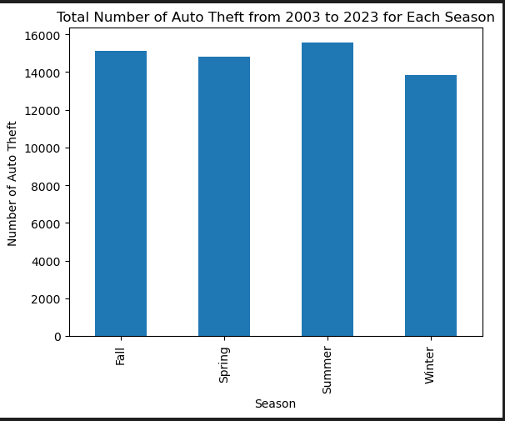
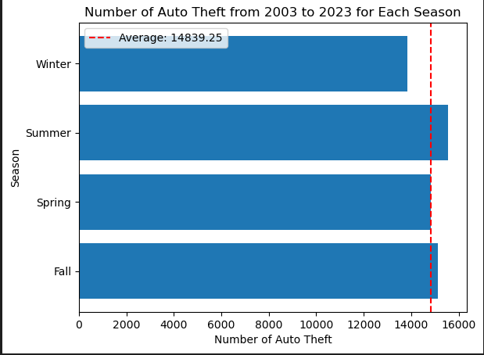
Overall and Averages Data of Auto Theft

Slide 2
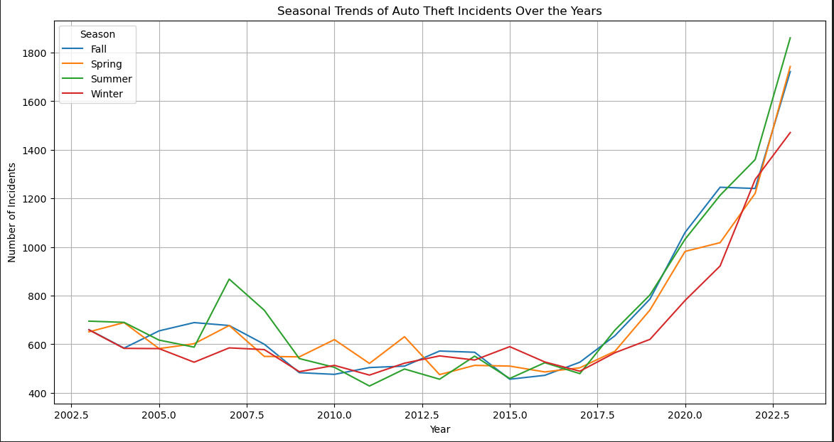

Slide 3
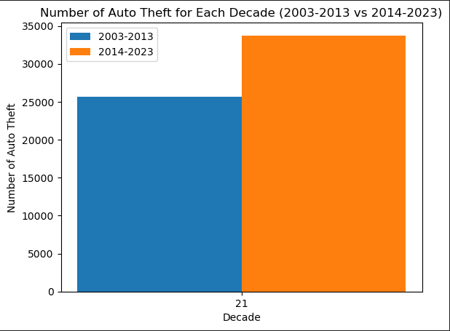

Slide 4
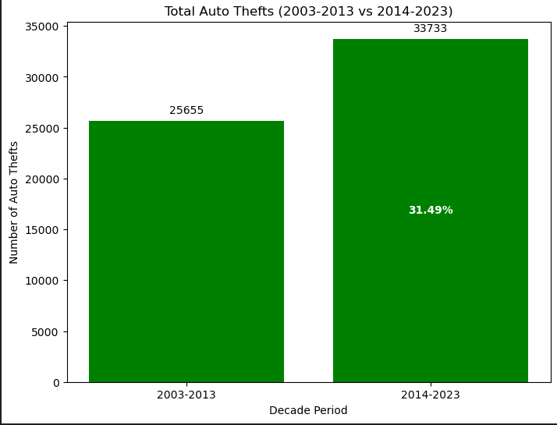
Increase in Number of Occurrences Compared to Previous Decade

Slide 5
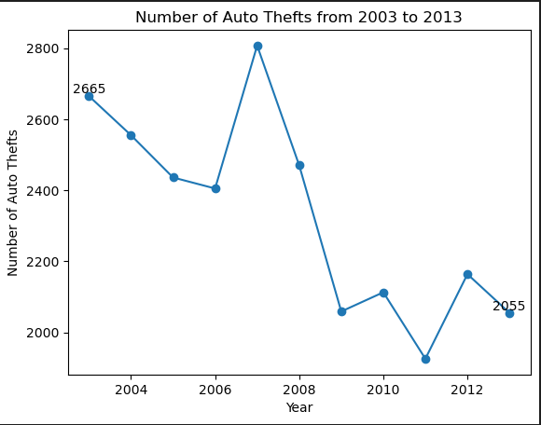
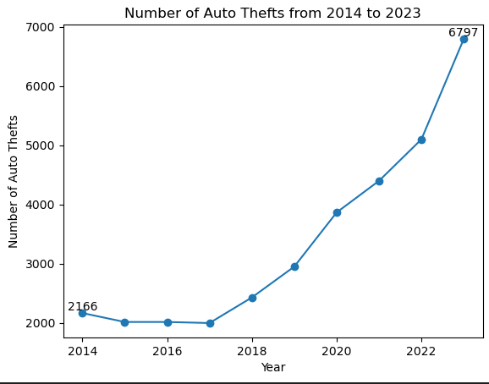
Comparison of Occurrences Between Two Ten Year Periods
Auto Thefts Between 2003-2013 -22.89% of 25,655 Total Occurrences
Auto Thefts Between 2014-2023 +213.80% of 33,733 Total Occurrences

Slide 6
